Slide 1

Predicting customer buying behaviour

Slide 2
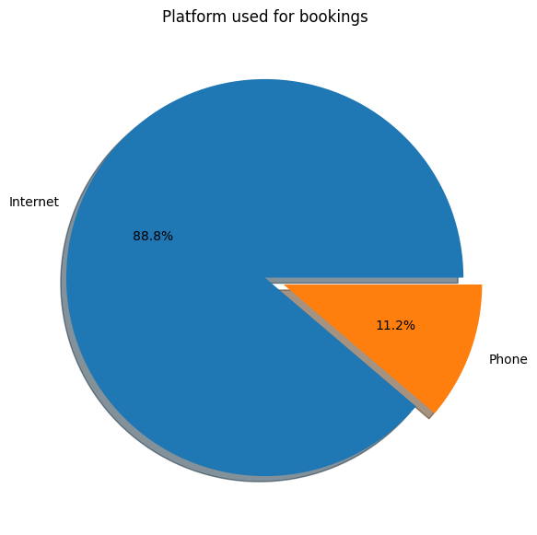
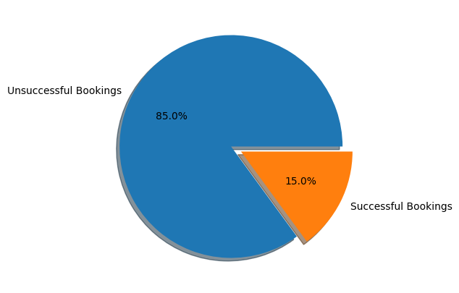

Slide 3
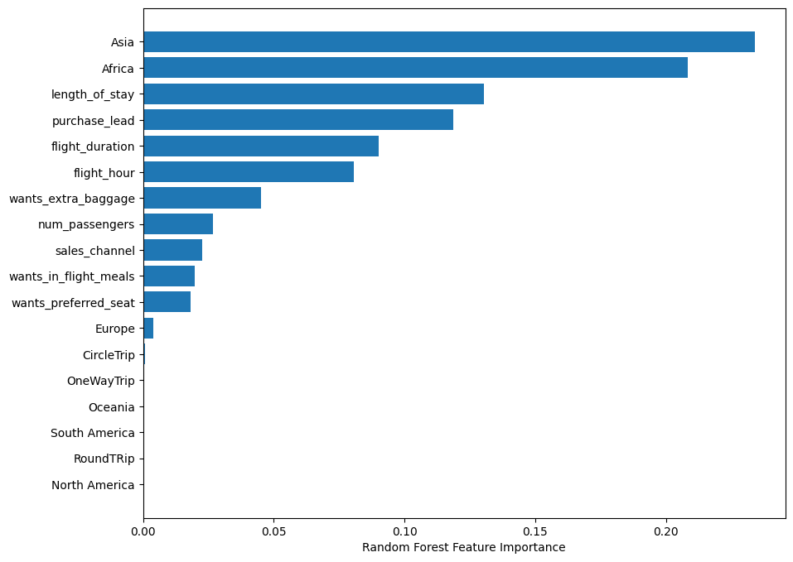
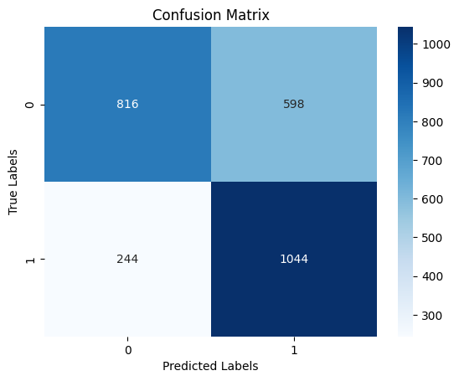

Slide 4
OBSERVATIONS
While the day of booking does not seem to be a significant factor, it is observed that most tickets were booked on Mondays.
The country of origin is found to be a crucial factor for prediction.
The internet, specifically the website and mobile app, is where most bookings are made, indicating a need to focus on these areas.
In order to achieve good accuracy and F1 score, it is recommended to balance the dataset.
Accuracy
69%
F1-Score
71

